Slide 1
Innovation Management Telecommunication Industry
Presented By :
Prajwal Baghele

Slide 2
Objectives of this Presentation
What are we going to get here :
You will get different views from Industry Leaders on Innovation and a definition of ‘Innovation’
You will learn a systematic model of 12 dimensions describing different aspects of Innovation
You will see examples in industry of important Innovations
You will learn a framework to describe the Dynamics of Innovation

Slide 3
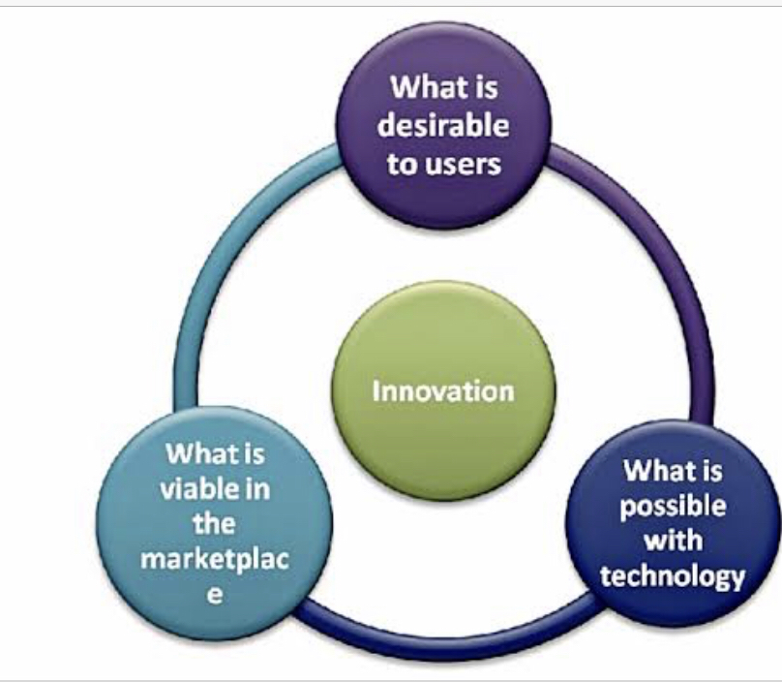
What is the importance of Innovation?
IMPORTANCE

Slide 4
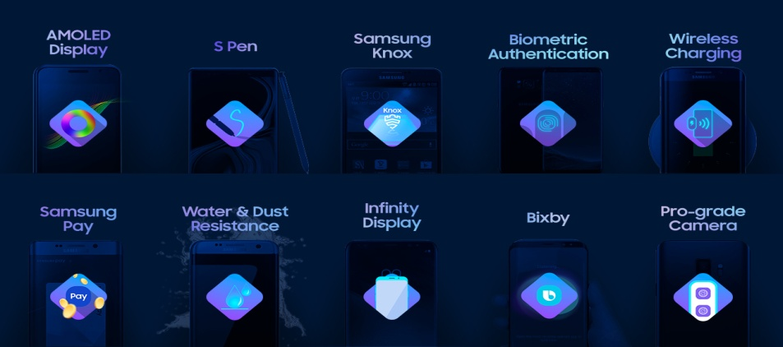


SAMSUNG
The Samsung foldable screen,
a Disruptive Innovation.
Technological breakthrough,
a Radical Innovation.
Functional Improvement,
a Incremental Innovation.

Slide 5
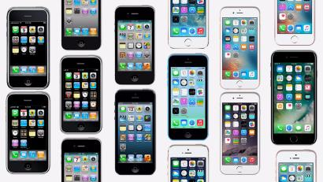
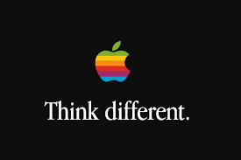
APPLE
iPhones computer toto existing phones , a
Incremental Innovation.
Disruptive to Incremental
Innovation.

Slide 6

AIRTEL
Industrial Revolution ,
a Disruptive Innovation.
Airtel’s Latest Innovation.

Slide 7
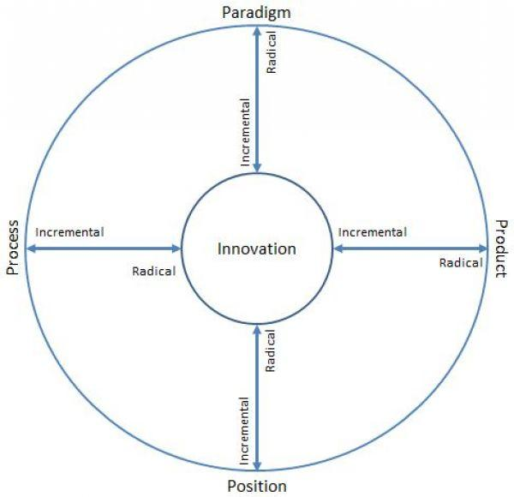
DIMENSIONS
Innovation dimensions can be divided into four different class. Dimensions are:
Product
Process
Position
Paradigm

Slide 8
Four Main Phases for Industry Development
The Product Innovation Phase (WHAT)
The Process Innovation phase (HOW)
The Expansion Phase (WHERE)
The Segmentation Phase (WHO)
DIMENSIONS

Slide 9
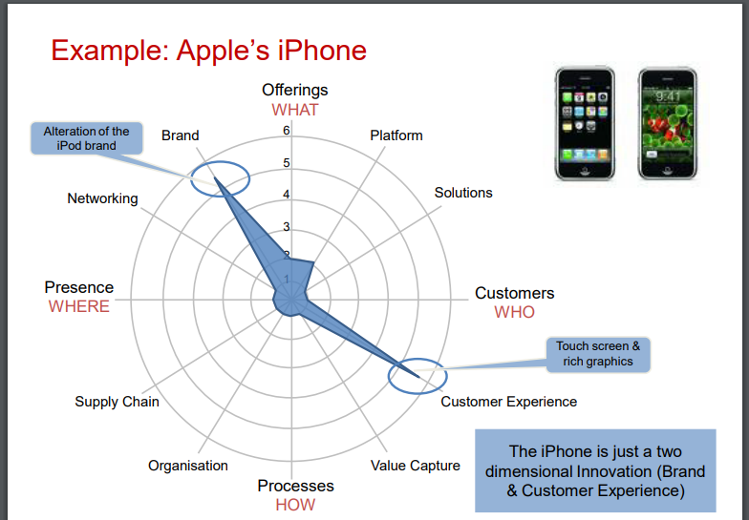

Slide 10
Innovation MATRIX
THE INNOVATION MATRIX IS A TOOL TO DEFINE THE INNOVATION STRATEGY THAT FITS One COMPANY
You define the benefits you expect from your innovation program, the Matrix will tell you the most suitable one.

Slide 11
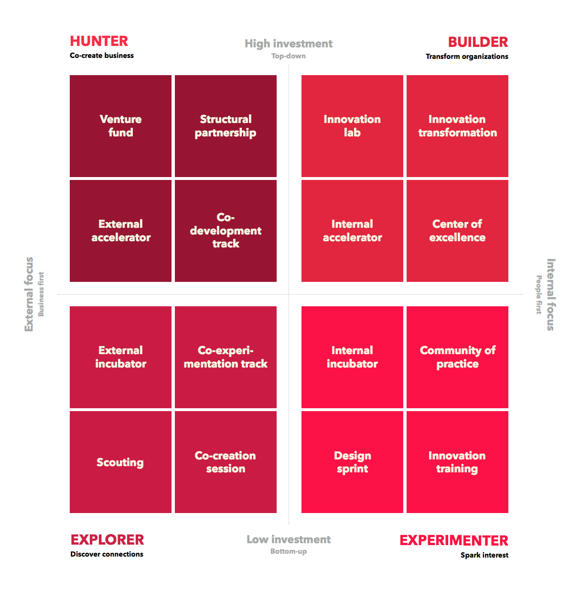
Types of Matrix
Hunter
Builder
Explorer
Experimenter

Slide 12
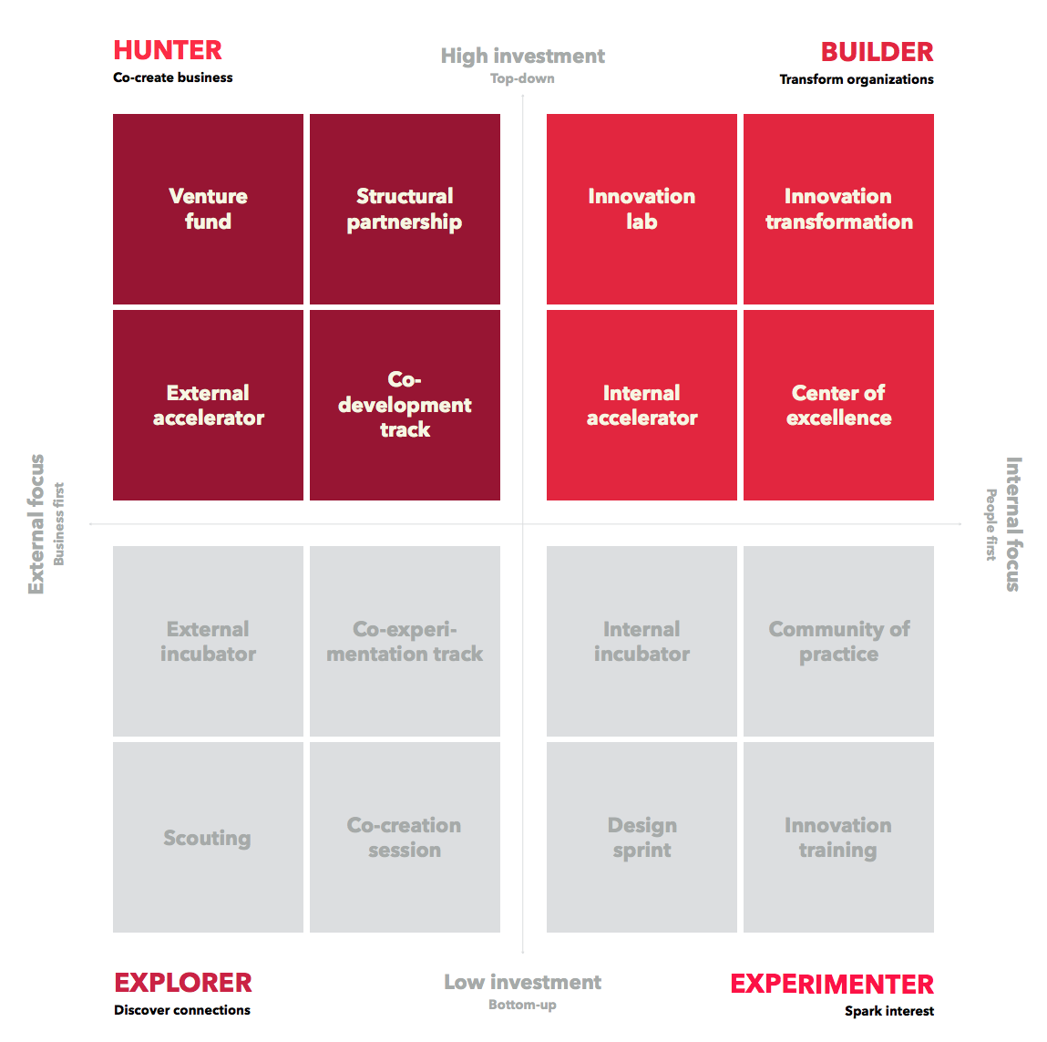
HUNTER/BUILDER Samsung’s strategy has traditionally been all about incremental innovation (its curved mobile phone screens are a prime example). The organization’s strategy in recent years has been to diversify its portfolio.
SAMSUNG’S ARCHETYPE

Slide 13
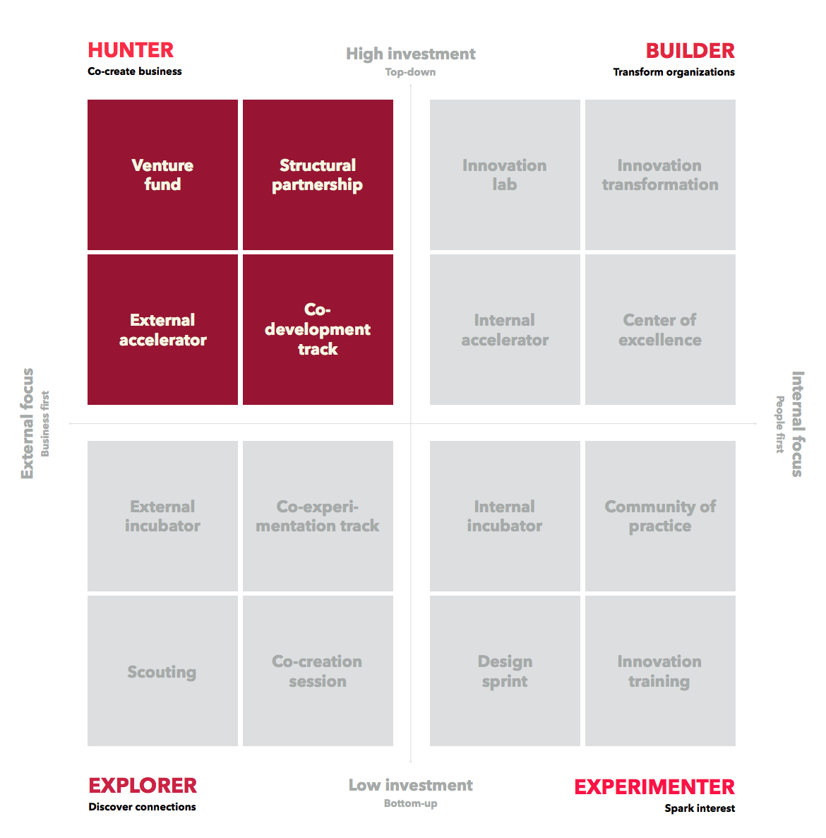
HUNTER Apple used to outsource R&D initiatives, preferring instead to focus on product development. But these days, they’re developing competencies in-house through internal accelerators while also acquiring start-ups.
APPLE’S ARCHETYPE

Slide 14
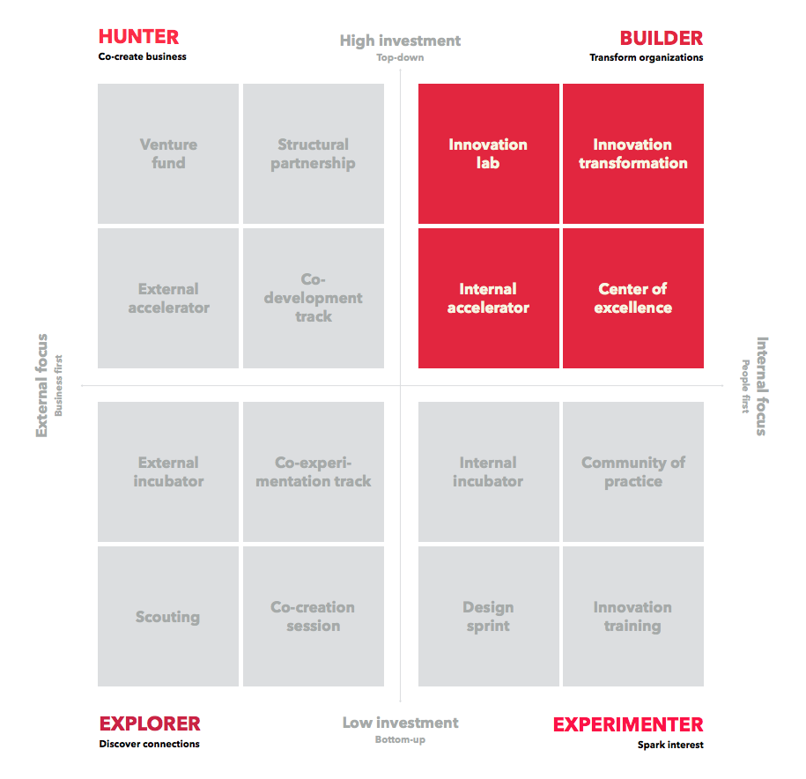
BUILDER Having achieved the impossible feat that is keeping its start-up culture while scaling up, innovation is ingrained in every part of AIRTEL’S culture – not just the R&D arm.
AIRTEL’S ARCHETYPE

Slide 15
Innovation Strategies
Innovation strategies are different from many business strategies, because of the difficulty of predicting the steps, time and impact of the innovation.
An innovative strategy guides decisions on how resources are to be used to meet a business's objectives for innovation, deliver value and build competitive advantage.

Slide 16

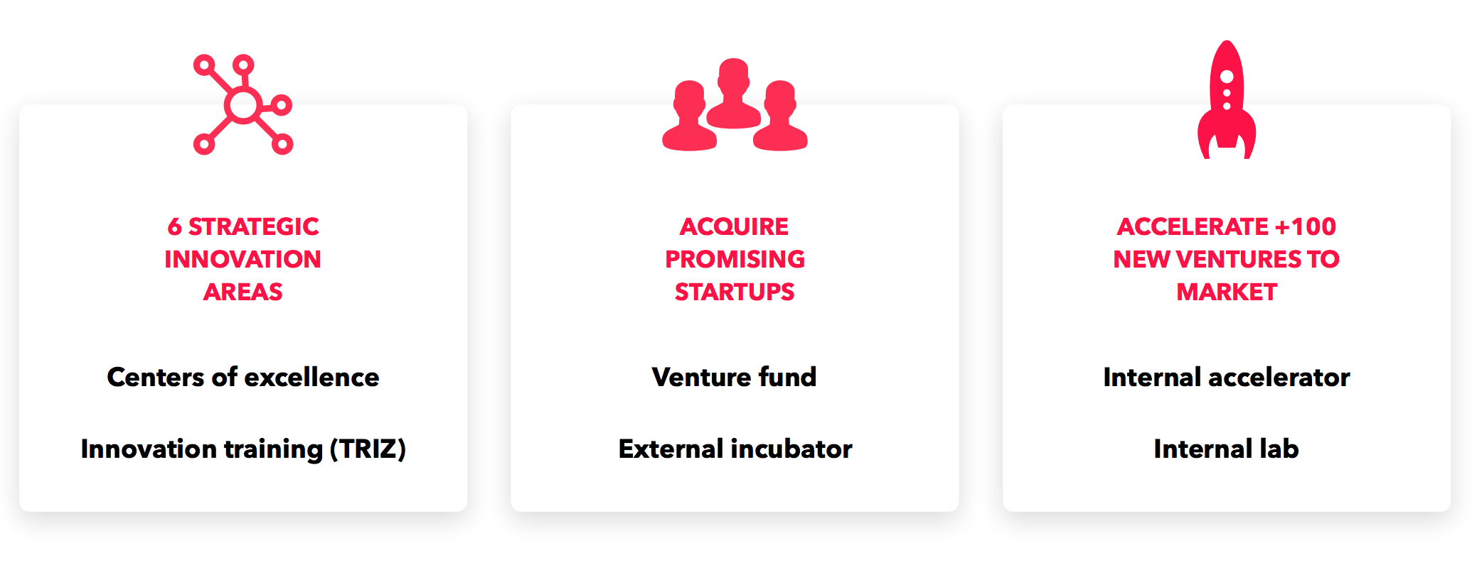
MISSION “We will devote our human resources and technology to create superior products and services, thereby contributing to a better global society.”
SAMSUNG’S STRATEGY

Slide 17

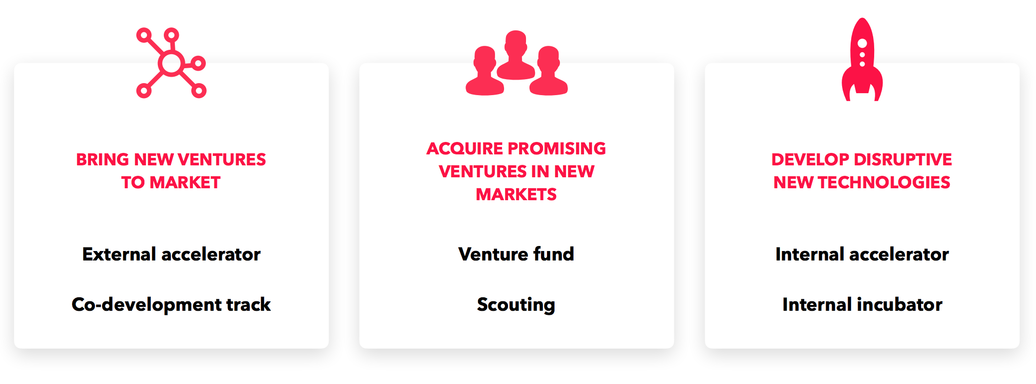
MISSION “Bringing the best user experience to its customers through its innovative hardware, software, and services.”
APPLE’S STRATEGY

Slide 18


MISSION “We are consistently fine-tuning our strategies and strengthening our innovative core to anticipate and lead change in the global digital landscape.”
AIRTEL’S STRATEGY

Slide 19
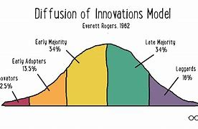
Diffusion of Innovation theory
Diffusion of innovations is a theory that seeks to explain how, why, and at what rate new ideas and technology spread.

Slide 20
Telecommunication industry
When a reputed brand launches a new product there are a few buyers who want to be the first customer in that particulat market.
Eg. ‘Apple iphone’ is one of the famous smartphone series. Before the company launches the product some customers have preordered the product regardless of price. They are known as Innovators.
Early respondents are the next fastest respondents. Youth usually represent this category. They take the risk to adapt to the innovation.
Apple

Slide 21
Samsung
When iPhone 4 was launched Samsung Galaxy S came in to compete with it.
Samsung Galaxy 2 also launched successfully and ruined the market for iPhone in India.
The user friendliness of Galaxy 2 and the Innovative features of Galaxy 3 created a big market share.
With the impressive pricing strategy and various benefits the Galaxy 3 got to the Early Majority level.
Telecommunication industry

Slide 22

Airtel
Airtel is one of the most old and prestigious players in the telecommunication industry.
Airtel introduced Postpaid plans and also Family plans.
With more innovations like 4G and a strong network , Airtel became reliable and got to the Late Majority and the Laggards level.
Telecommunication industry

Slide 23

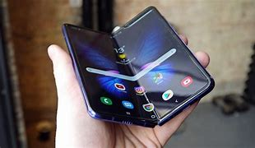
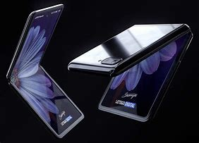
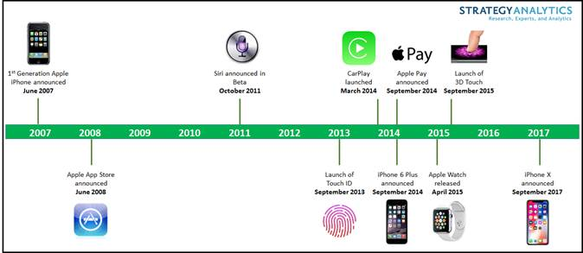
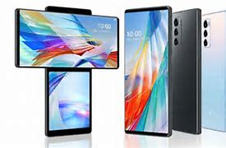
Conclusion

